Slide 1

NLP : Recurrent Neural Network
Video 2: Backward Propagation in RNN

Slide 2
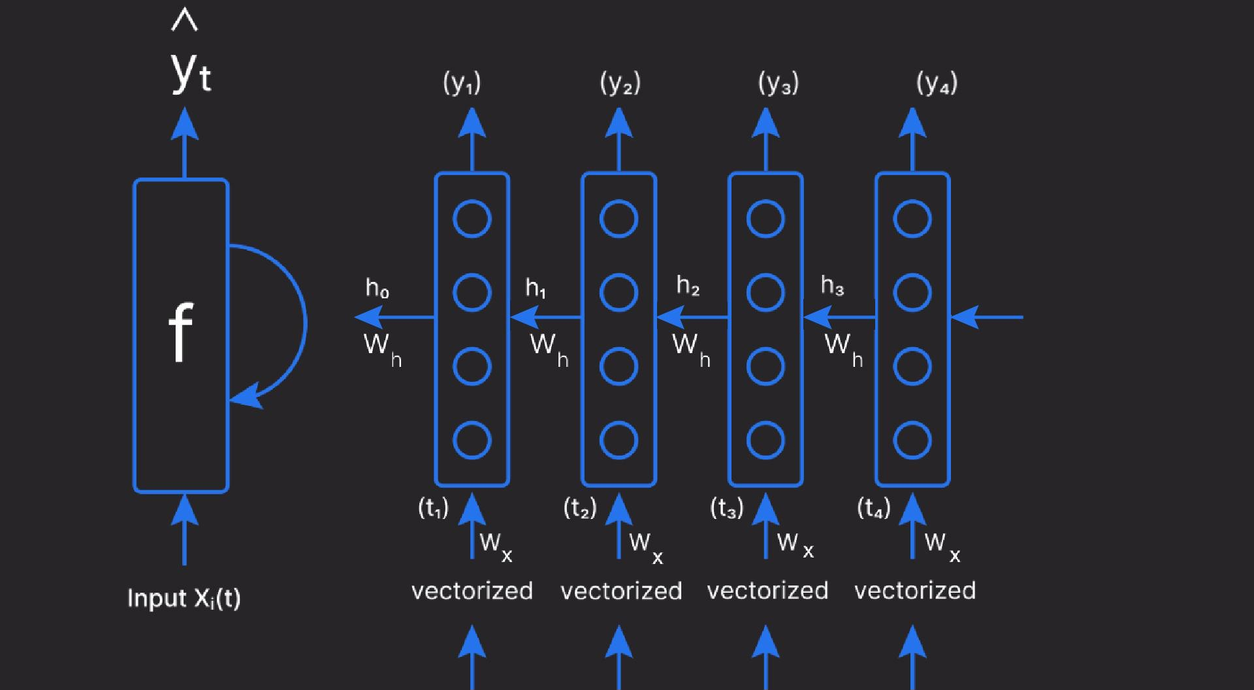
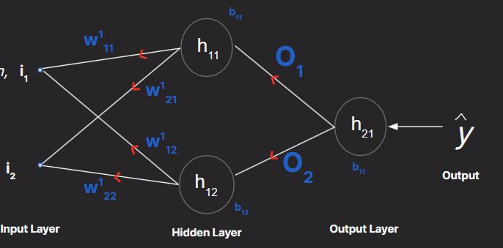
Backpropagation in ANN v/s RNN
Artificial Neural Network
Standard Backpropagation
Recurrent Neural Network
Backpropagation in RNN
Optimize network weights by minimizing the loss function.

Slide 3
Calculating the Loss
Loss is calculated at the output
^{L = Loss( y}predicted ^{, y}actual
)

Slide 4
Backward Pass
Calculates the error gradient at each time step
Chain Rule
How much each part of RNN contributes to the error

Slide 5

Backward Pass
Backpropagation through time (BPTT)

Slide 6
Types of RNN

